Slide 1
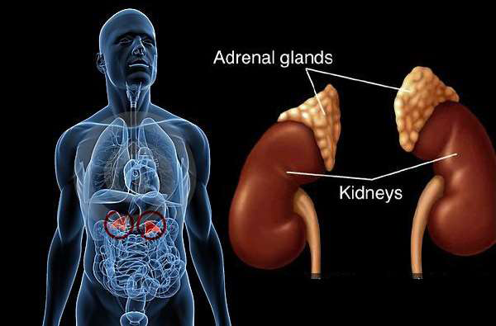
Disorders of adrenal gland

Slide 2
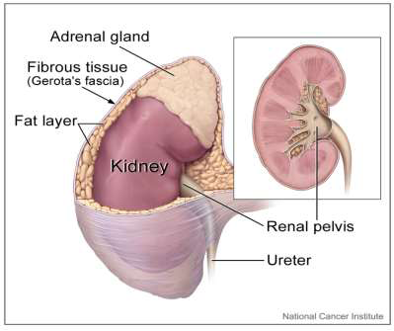
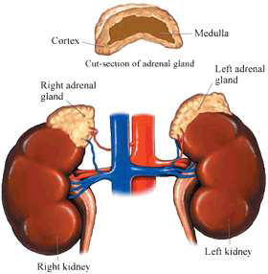
Anatomy of the adrenal gland
The adrenal gland is located on the upper segment of the kidney.
It consists of an outer cortex and an inner medulla.
Adrenal medulla secretes catecholamines (epinephrine and NE). It consists of thin layers of large chromaffin cells.

Slide 3
Adrenal cortex
It consists of three histologically distinct zones:
Outer zona glomerulosa (small, compact cells).
Zona fasciculata (larger, lipid-rich cells arranged in radial columns).
Innermost layer called the zona reticularis (compact & pigmented cells).
Each zone is responsible for production of different hormones.

Slide 4
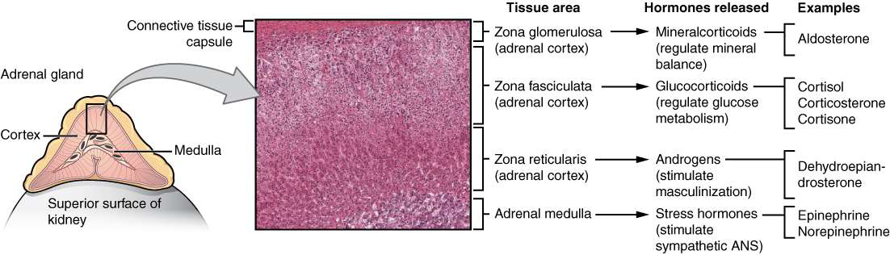
Adrenal cortex

Slide 5
Corticosteroids
They bind to specific intracellular cytoplasmic receptors in target tissues.
Glucocorticoid receptors are distributed throughout the body, whereas mineralocorticoid receptors are confined mainly to excretory organs, such as the kidney, colon, salivary glands and sweat glands. Both types of receptors are found in the brain.
After binding with receptors, the resulting complex acts as a transcription factor to turn genes on (when complexed with coactivators) or off (when complexed with corepressors), depending on the tissue.

Slide 6
Adrenal gland physiology
Aldosterone promotes renal sodium retention and potassium excretion.
Its synthesis and release are regulated by renin in response to decreased vascular volume and renal perfusion.
Adrenal aldosterone production is regulated by the renin-angiotensin-aldosterone system.

Slide 7
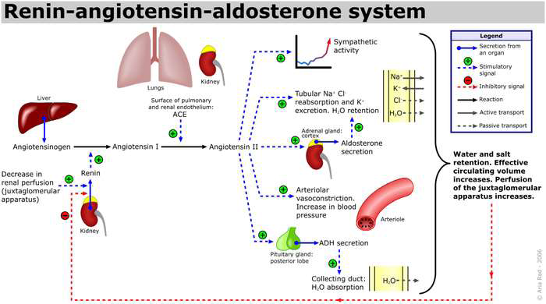

Slide 8
Physiology
Cortisol
Its secretion follows a circadian rhythm, generally beginning to rise at approximately 3 to 4 am and peaking around 6 to 8 am.
Promote normal intermediary metabolism:
Favor gluconeogenesis through increasing amino acid uptake by the liver and kidney and elevating activities of gluconeogenic enzymes.
Stimulate protein catabolism (except in the liver) and lipolysis, thus providing the building blocks and energy needed for glucose synthesis

Slide 9
Physiology
Increase resistance to stress:
By raising plasma glucose levels, provide the body with energy to combat stress caused by trauma, fright, infection, bleeding.
Alter blood cell levels in plasma:
Cause a decrease in eosinophils, basophils, monocytes, and lymphocytes by redistributing them from the circulation to lymphoid tissue. Also, increase Hb, erythrocytes, platelets, and polymorphonuclear leukocytes.

Slide 10
Physiology
Anti-inflammatory action: they have Potent anti-inflammatory and immunosuppressive activities through:
The lowering of circulating lymphocytes.
Inhibiting the ability of leukocytes and macrophages to respond to mitogens and antigens.
Decreasing the production and release of proinflammatory cytokines.
Inhibiting phospholipase A2, which blocks the release of arachidonic acid (the precursor of the prostaglandins and leukotrienes) from membrane-bound phospholipid.
Stabilizing mast cell and basophil membranes, resulting in decreased histamine release

Slide 11
Physiology
Production of cortisol increases in certain conditions such as physiologic stress, alcoholism, depression, anxiety disorder, starvation, anorexia and chronic renal failure.
High total cortisol levels are also observed in the presence of increased cortisol binding globulin (the carrier protein for 80% of circulating cortisol molecules), which is seen in pregnancy or other high-estrogen states (eg, exogenous estrogen administration).
Cortisol is converted in the liver to an inactive metabolite known as cortisone.

Slide 12
Physiology
Androgens: Only a small amount of testosterone and estrogen is produced in the adrenal glands.
Physiologically insignificant.
Becomes useful during menopause in women.

Slide 13
Regulation of adrenal gland function
Adrenal hormone production is controlled by the hypothalamus and pituitary.
Corticotropin-releasing hormone (CRH) is secreted by the hypothalamus and stimulates secretion of adrenocorticotropic hormone (ACTH or corticotropin) from the anterior pituitary.
ACTH stimulates the adrenal cortex to produce cortisol.
When sufficient or excessive cortisol levels are reached, a negative feedback is exerted on the secretion of CRH and ACTH, thereby decreasing overall cortisol production.

Slide 14
Therapeutic uses of corticosteroids
Relief of inflammatory symptoms:
Rheumatoid arthritis and inflammatory skin conditions.
Maintenance of symptom control in persistent asthma, management of asthma exacerbations and active IBD.
Treatment of allergies:
Allergic rhinitis, drug, serum, and transfusion allergic reactions.
Acceleration of lung maturation:
Respiratory distress syndrome is a problem in premature infants. Fetal cortisol is a regulator of lung maturation.
A regimen of betamethasone or dexamethasone is given IM to the mother within the 48 hours proceeding premature delivery to accelerate lung maturation in the fetus.

Slide 15
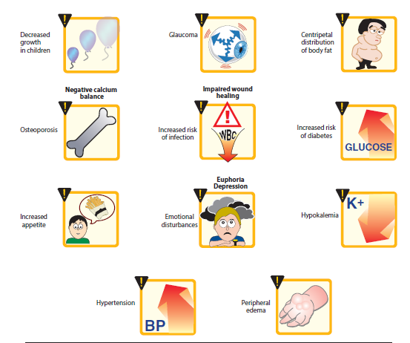
Side effects of corticosteroids
Notes:
Osteoporosis is the most common adverse effect due to the ability of glucocorticoids to suppress intestinal Ca2+ absorption, inhibit bone formation, and decrease sex hormone synthesis

Slide 16
Adrenal gland disorders

Slide 17
Overview
Hypofunction may be primary (malfunction of the adrenal gland itself, as in Addison's disease) or secondary (due to lack of adrenal stimulation by the pituitary or hypothalamus “3ary”).
Hyperfunction produces distinct clinical syndromes.
Hypersecretion of :
Androgens: adrenal virilism.
Glucocorticoids: Cushing's syndrome.
Aldosterone: aldosteronism

Slide 18
Adrenal disorders
Hyperfunction may be compensatory (congenital adrenal hyperplasia), or due to acquired hyperplasia (adenomas or adenocarcinomas).
Excess quantities of epinephrine and NE are produced in pheochromocytoma.

Slide 19
Hyperaldosteronism
Primary
leads to retention of salt and loss of potassium with hypertension and hypokalemia (conn’s syndrome).
Due to adrenal adenoma.
Management: surgery, aldactone(aldosterone antagonist).
Secondary
when the excess aldosterone is caused by something outside the adrenal gland and mimics the primary condition (RENIN – ANGIOTENSIN SYSTEM)
Increased renin production, commonly caused by oral contraceptives and toxemia from pregnancy

Slide 20
Congenital adrenal hyperplasia
Autosomal recessive disorder caused by enzymatic defect in the synthetic pathway of cortisol & other steroid from cholesterol (95% : 21-hydroxylase deficiency).
Cortisol secretion is reduced and feedback leads to increased ACTH secretion to maintain adequate cortisol leading to adrenal hyperplasia.
Diversion of the steroid precursors into the androgenic steroid pathways occurs. Thus, 17-hydroxyprogesterone and testosterone levels are increased, leading to virilization
Causes adrenal insufficiency in children.
Treated by cortisol replacement.

Slide 21
Adrenal insufficiency (Addison’s disease)

Slide 22
Etiology
Adrenal insufficiency generally refers to the inability of adrenal glands to produce adequate amounts of cortisol for normal physiologic functioning or in times of stress.
The condition is usually classified as primary, secondary, or tertiary, depending on the etiology
More prevalent in women than in men.

Slide 23
Etiology
Primary adrenal insufficiency:
Autoimmune (70%–90% of all cases).
Infectious (cytomegalovirus, fungal, HIV, TB).
Bilateral adrenal hemorrhage (usually due to anticoagulant therapy).
Adrenalectomy
Genetic causes (congenital adrenal hyperplasia, familial glucocorticoid deficiency )
Metastatic malignancy

Slide 24
Pathophysiology
In general, the clinical manifestations are observed when destruction of the cortex exceeds 90%.
Signs and symptoms of adrenal insufficiency reflect the disturbance of normal physiologic carbohydrate, fat, and protein homeostasis caused by inadequate cortisol production and action.
Primary adrenal insufficiency usually develops gradually. Patients may remain asymptomatic in the early stages with symptoms present only during times of physiologic stress.

Slide 25
Pathophysiology
It may be accompanied by a reduction in aldosterone and androgen production.
Chronic adrenal insufficiency (rare) has a good prognosis if diagnosed early.
Acute adrenal insufficiency (adrenal crisis) results from the body’s inability to sufficiently increase endogenous cortisol during periods of excessive physiologic stress (surgery, infection, trauma).
Drugs associated with adrenal insufficiency include those that inhibit production (eg, ketoconazole) or increase metabolism (eg, the cytochrome P-450 3A4 inducer rifampin) of cortisol

Slide 26
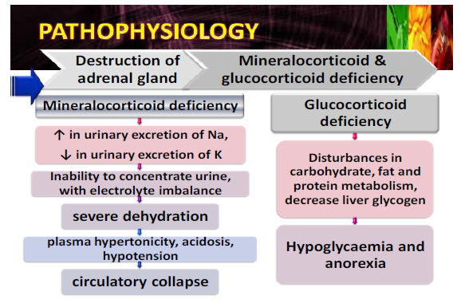
Symptoms & signs

Slide 27
Symptoms
Weakness and fatigue (99%)
Anorexia, nausea, and diarrhea (56%–90%)
Hypoglycemia
Amenorrhea
Salt craving occurs in due to aldosterone deficiency
Weight loss
Hypotension
Dehydration, hypovolemia, hyperkalemia, hyponatremia
Increased serum urea and creatinine (dehydration)
Hyperpigmentation of skin and mucous membranes (92%)due to high ACTH
Dark freckles and patches of vitiligo
Personality changes

Slide 28

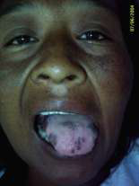
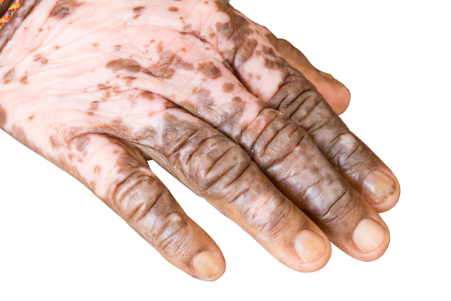

Slide 29
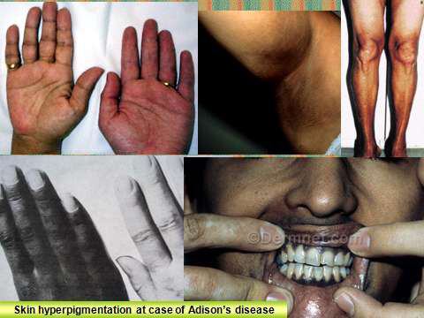

Slide 30
Diagnosis
Laboratory Tests
Decreased basal and stress-induced cortisol levels.
Decreased aldosterone level (in primary insufficiency only).
Lack of increase in cortisol and aldosterone level after ACTH stimulation.
Other Diagnostic Tests
CT scan or MRI of the adrenal glands, pituitary or hypothalamus can aid in determining etiology.
Presence of antiadrenal antibodies is suggestive of an autoimmune etiology.

Slide 31
Diagnosis
Insulin-induced hypoglycemia test:
Occasionally, doctors suggest this test for 2ary adrenal insufficiency.
It involves checking the blood glucose and cortisol levels at various intervals after an injection of insulin.
In healthy people, glucose levels fall and cortisol levels increase

Slide 32
Treatment
Lifelong glucocorticoid replacement therapy may be necessary.
Mineralocorticoid replacement therapy is usually required (not for 2ary insufficiency as aldosterone levels not affected).
Glucocorticoids with sufficient mineralocorticoid activity are generally required (hydrocortisone).
The addition of a potent mineralocorticoid (fludrocortisone) with adequate salt intake, is sometimes needed to prevent sodium loss, hyperkalemia.

Slide 33
Treatment
In adults, 15–25 mg/day of oral hydrocortisone is typically administered in two divided doses:
Two-thirds of the dose given in the morning upon awakening to mimic the early morning rise in endogenous cortisol.
The remaining one-third is given in the late afternoon to avoid insomnia and allow for lowest concentration in the blood around midnight.
The longer acting glucocorticoids (eg, prednisone, dexamethasone) may provide a more prolonged clinical response.

Slide 34
Treatment
Patients should be educated regarding the need for increased glucocorticoid dosage during excessive physiologic stress.
Treating androgen deficiency with an androgen replacement (dehydroepiandrosterone DHEA) is recommended for females. It may improve overall sense of well-being.

Slide 35
Treatment
Adrenal crisis:
It is a life-threatening situation that resulting in hypotension, hypoglycemia, hyperkalemia.
This situation requires immediate medical care.
Treatment includes intravenous injections of:
1. Hydrocortisone
2. Saline solution
3. Sugar (dextrose)

Slide 36
Cushing syndrome

Slide 37
Etiology
It refers to the pathophysiologic changes associated with exposure to supraphysiologic cortisol concentrations (endogenous hypercortisolism) or pharmacologic doses of glucocorticoids (exogenous hypercortisolism).
Cushing syndrome from endogenous causes is a rare condition.
Patients receiving chronic supraphysiologic doses of glucocorticoids (rheumatologic disorders) are at high risk.

Slide 38
Pathophysiology
Cushing syndrome can be classified as:
a) ACTH-dependent:
ACTH secreting pituitary adenoma
ACTH-secreting nonpituitary tumors (ectopic ACTH syndrome); usually from small cell lung carcinoma, thymus, pancreatic or ovarian tumor
CRH-secreting nonpituitary tumors (rare)

Slide 39
Pathophysiology
b) ACTH-independent:
Excessive cortisol secretion by the adrenal glands (Unilateral adrenal adenoma, Adrenal carcinoma, Bilateral nodular adrenal hyperplasia “rare”).
Exogenous glucocorticoid administration including herbal products with glucocorticoid activity, Other drugs with glucocorticoid activity (eg, megestrol acetate, medroxyprogesterone).
The plasma ACTH concentration is elevated in ACTH-dependent conditions but not in ACTH-independent (elevated cortisol concentrations suppress ACTH secretion via negative feedback).

Slide 40
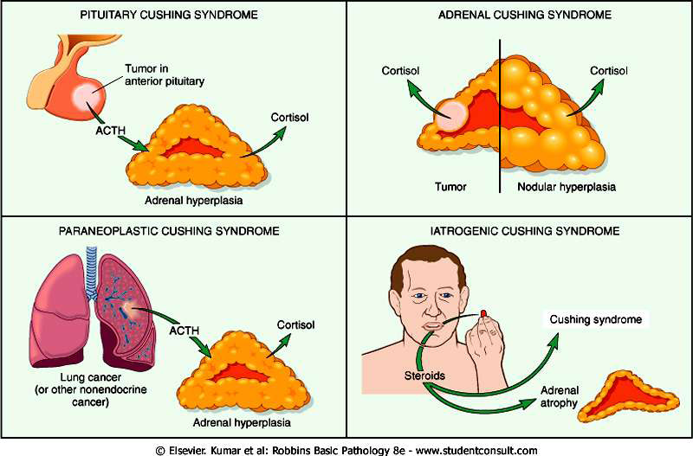

Slide 41
Signs and synptoms
Weight gain
Rounded moon face
Dorsocervical (“buffalo hump”) and supraclavicular fat accumulation
Hirsutism (75%), acne, menstrual irregularities and virilization in women (oversecretion of androgens).
Facial plethora (flushing).
Skin striae (“stretch marks” that are red or purple in appearance and greater than 1 cm).
Easy bruising (40%)

Slide 42
Symptoms
Hyperglycemia
Hyperlipidemia (70%)
Psychiatric changes (depression, psychosis, euphoria, anxiety, and decreased cognition) (85%)
Sleep disturbances
Osteopenia (80%) and osteoporosis
Impaired wound healing
Thining of limbs

Slide 43
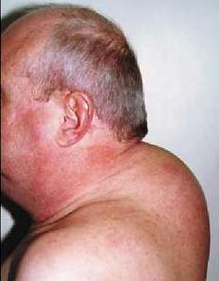
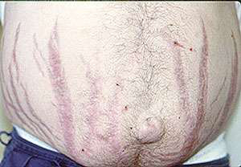
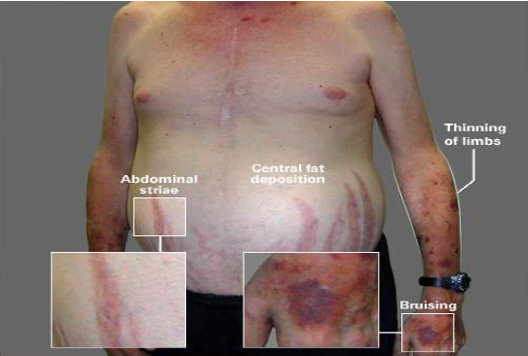
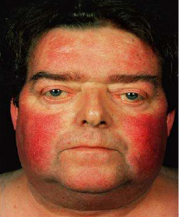

Slide 44
Diagnosis
Overnight dexamethasone suppression test.
Late-night salivary cortisol test.
Imaging studies to distinguish between pituitary, ectopic, and adrenal tumors.

Slide 45
Treatment
Surgical resection is the treatment of choice for Cushing syndrome from endogenous causes if the tumor can be localized.
The treatment of choice for Cushing syndrome from exogenous causes is gradual discontinuation of the agent.

Slide 46
Treatment
Non pharmacologic:
Transsphenoidal pituitary microsurgery (removal of pituitary tumor). HPA axis suppression can result in prolonged adrenal insufficiency lasting for months after surgery and requiring exogenous glucocorticoid.
Pituitary irradiation or bilateral adrenalectomy (for relapse after pituitary surgery).
The treatment of choice in patients with adrenal adenomas is unilateral laparoscopic adrenalectomy.

Slide 47
Treatment
Pharmacologic treatment is indicated when:
The ectopic ACTH secreting tumor cannot be localized
Control hypercortisolism to prepare for surgery
In patients who are not surgical candidates; failed surgery or had a relapse after surgery.
The most widely used therapeutic class is the adrenal steroidogenesis inhibitor (nhibiting enzymes involved in the biosynthesis of cortisol).
Because of their potential to cause adrenal suppression, temporary glucocorticoid replacement may be needed.

Slide 48
Treatment
Ketoconazole: inhibit 17-hydroxylase, 11β-hydroxylase and cholesterol synthesis.
Metyrapone: Inhibits 11β-hydroxylase, aldosterone synthesis.
Etomidate: inhibit 17-hydroxylase, 11β-hydroxylase .

Slide 49
To Prevent Hypercortisolism
Give the lowest glucocorticoid dose that will manage the disease and for the shortest possible duration
If feasible, give glucocorticoid via administration routes that minimize systemic absorption (such as inhalation or dermal).
If feasible, administer glucocorticoid treatment every other day (calculate the total 48-hour dose and give as a single dose of intermediate acting glucocorticoid in the morning).
Avoid concurrent administration of drugs that can inhibit glucocorticoid metabolism.

Slide 50
To Prevent Hypocortisolism
Gradually taper the dose to about 20 mg of prednisone per day.
Change glucocorticoid to every other day administration, in the morning
Stop the glucocorticoid when the equivalent physiologic dose is reached.

